Slide 1
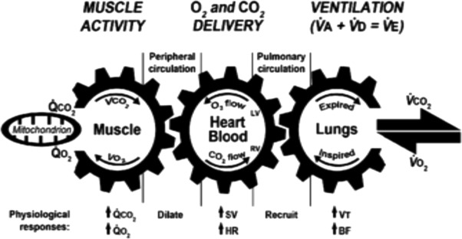
Brian Locke R.I.P. May/2022

Slide 2
Overall research hypotheses:
Surprisingly little is known about the epidemiology Hypercapnic Respiratory Failure
Yet, the limited evidence suggests high morbidity and mortality
Broad “syndrome” definitions are most useful for improving processes of care, yet no effective processes of care exist for hypercapnic respiratory failure.
’Surviving Sepsis’, LTVV, GDMT, etc….
There is an unmet need to understand:
Who these patients are, what is the personal/societal burden, who should be studied for management strategies.

Slide 3

How common are admissions with hypercapnia?
New in 2022: Liverpool AUS, 1 regional hospital services the district
Identified by initial ABG (w/n 24h) PaCO2 over 45, excluded iatrogenic causes/sedation. N=891 people, 1135 blood gasses (repeat hosp.)
Normalized rates of hypercapnia to population demographics
150 per 100,000 person/year, Acidosis in 55%.
Compared to Age 45-54:
RR 55-64: 2.1
RR 65-74: 6.2
RR 75-84: 15.7
RR 85-94: 26.2

Slide 4

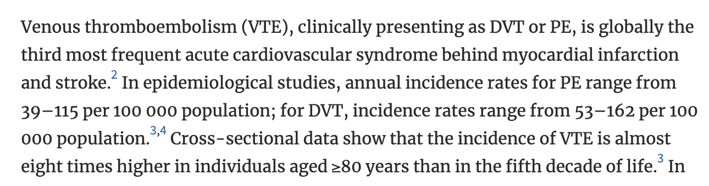
How common are admissions with hypercapnia?
New in 2022: Liverpool AUS, 1 regional hospital services the district
Identified by initial ABG (w/n 24h) PaCO2 over 45, excluded iatrogenic causes/sedation. N=891 people, 1135 blood gasses (repeat hosp.)
Normalized rates of hypercapnia to population demographics
150 per 100,000 person/year, Acidosis in 55%.
Compared to Age 45-54:
RR 55-64: 2.1
RR 65-74: 6.2
RR 75-84: 15.7
RR 85-94: 26.2

Slide 5

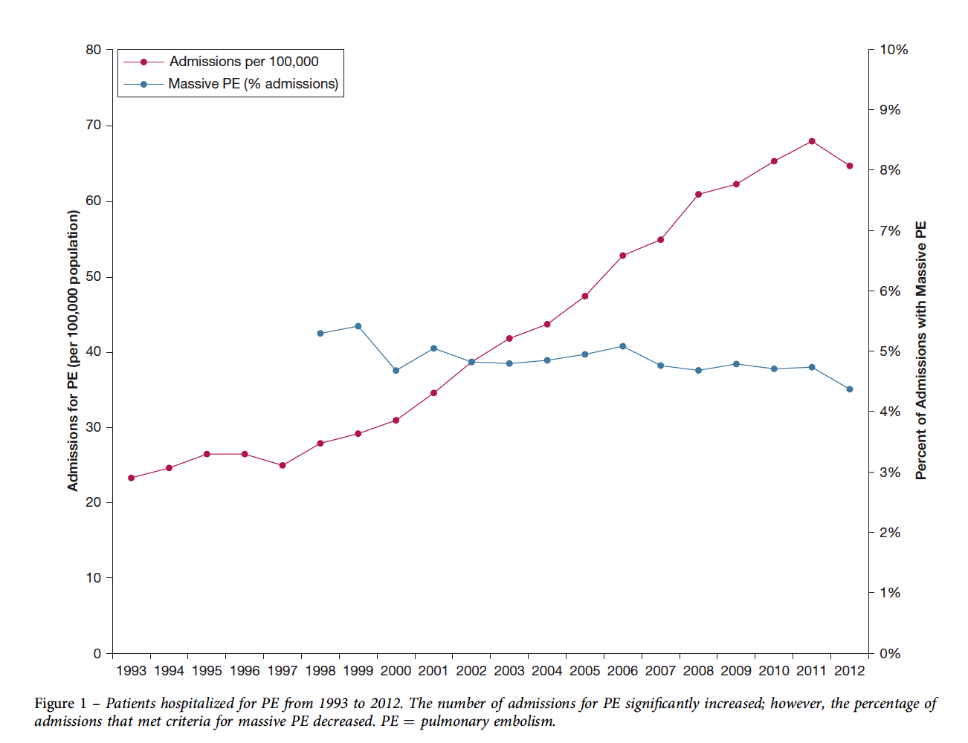
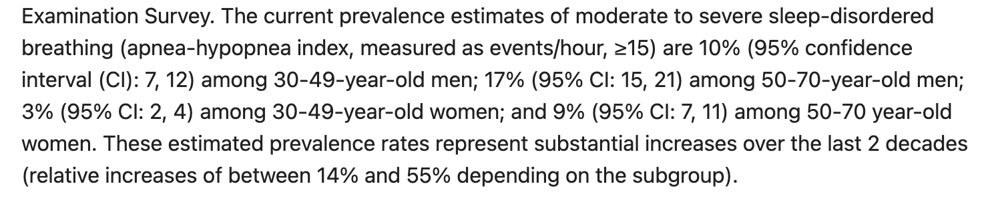
Are admissions with hypercapnia becoming more common?
Hypercapnia
Maybe?
Obesity Rates- USA
ICD Code for PE
This method will not work for hypercapnia

Slide 6
Admissions with hypercapnia indicate high risk of morbidity; may be driven by treatable conditions
30d Readmission rate: 23% (2/3 recurrence)
~= CHF. > than MI, AECOPD, PNa
Admitted (ICU or floor) with one of the following diagnostic codes:
J96.02 (acute hypercapnic respiratory failure)
J96.22 (acute and chronic respiratory failure with hypercapnia)
J96.92 (respiratory failure unspecified with hypercapnia)
J96.12 (chronic respiratory failure with hypercapnia)
E66.2 (morbid obesity with hypoventilation)
Admitted to hospital (Floor or ICU) with ABG showing PaCO2 over 45 mmHg and pH 7.35-7.45
 | COPD (2/3) | No COPD (1/3)
AHI Median [IQR] | 31.9 [14.3, 45.6] | 66.0 [48.0, 83.8]
AHI > 5 present | 66% | 94%
AHI > 15 present | 51% | 81%
1. Admitted to the ICU
2. PaCO2 greater than 47.25 mmHg
3. Procedure code for non-invasive ventilation or invasive mechanical ventilation initiation
Notes:
Exclusion of other causes of hypoventilation
Obesity -> increased CO2 production and vent limitation from mass of chest wall and disadvantaged respiratory mechanics
“Other Causes”: Obstructive lung disease, neuromuscular / chest wall disease, things that suppress ventilatory drive (opiates), or causes of metabolic alkalosis (loop diuretics)
Likely routine to you all, but this is often botched in pulmonary and inpatient medicine.
Exclusion parameter
In research studies: A patient with mild COPD cannot have OHS. In reality – what do you do with a patient who has COPD so mild that it doesn’t cause OHS? Or, if it’s mild enough that it wouldn’t cause hypercapnia on it’s own? Open questions, problem with the paradigm.
“Exclusion of other causes of hypoventilation
Severe obstructive respiratory disease
Severe interstitial lung disease
Severe chest-wall disorders (eg, kyphoscoliosis)
Severe hypothyroidism
Neuromuscular disease
Congenital hypoventilation syndromes”

Slide 7
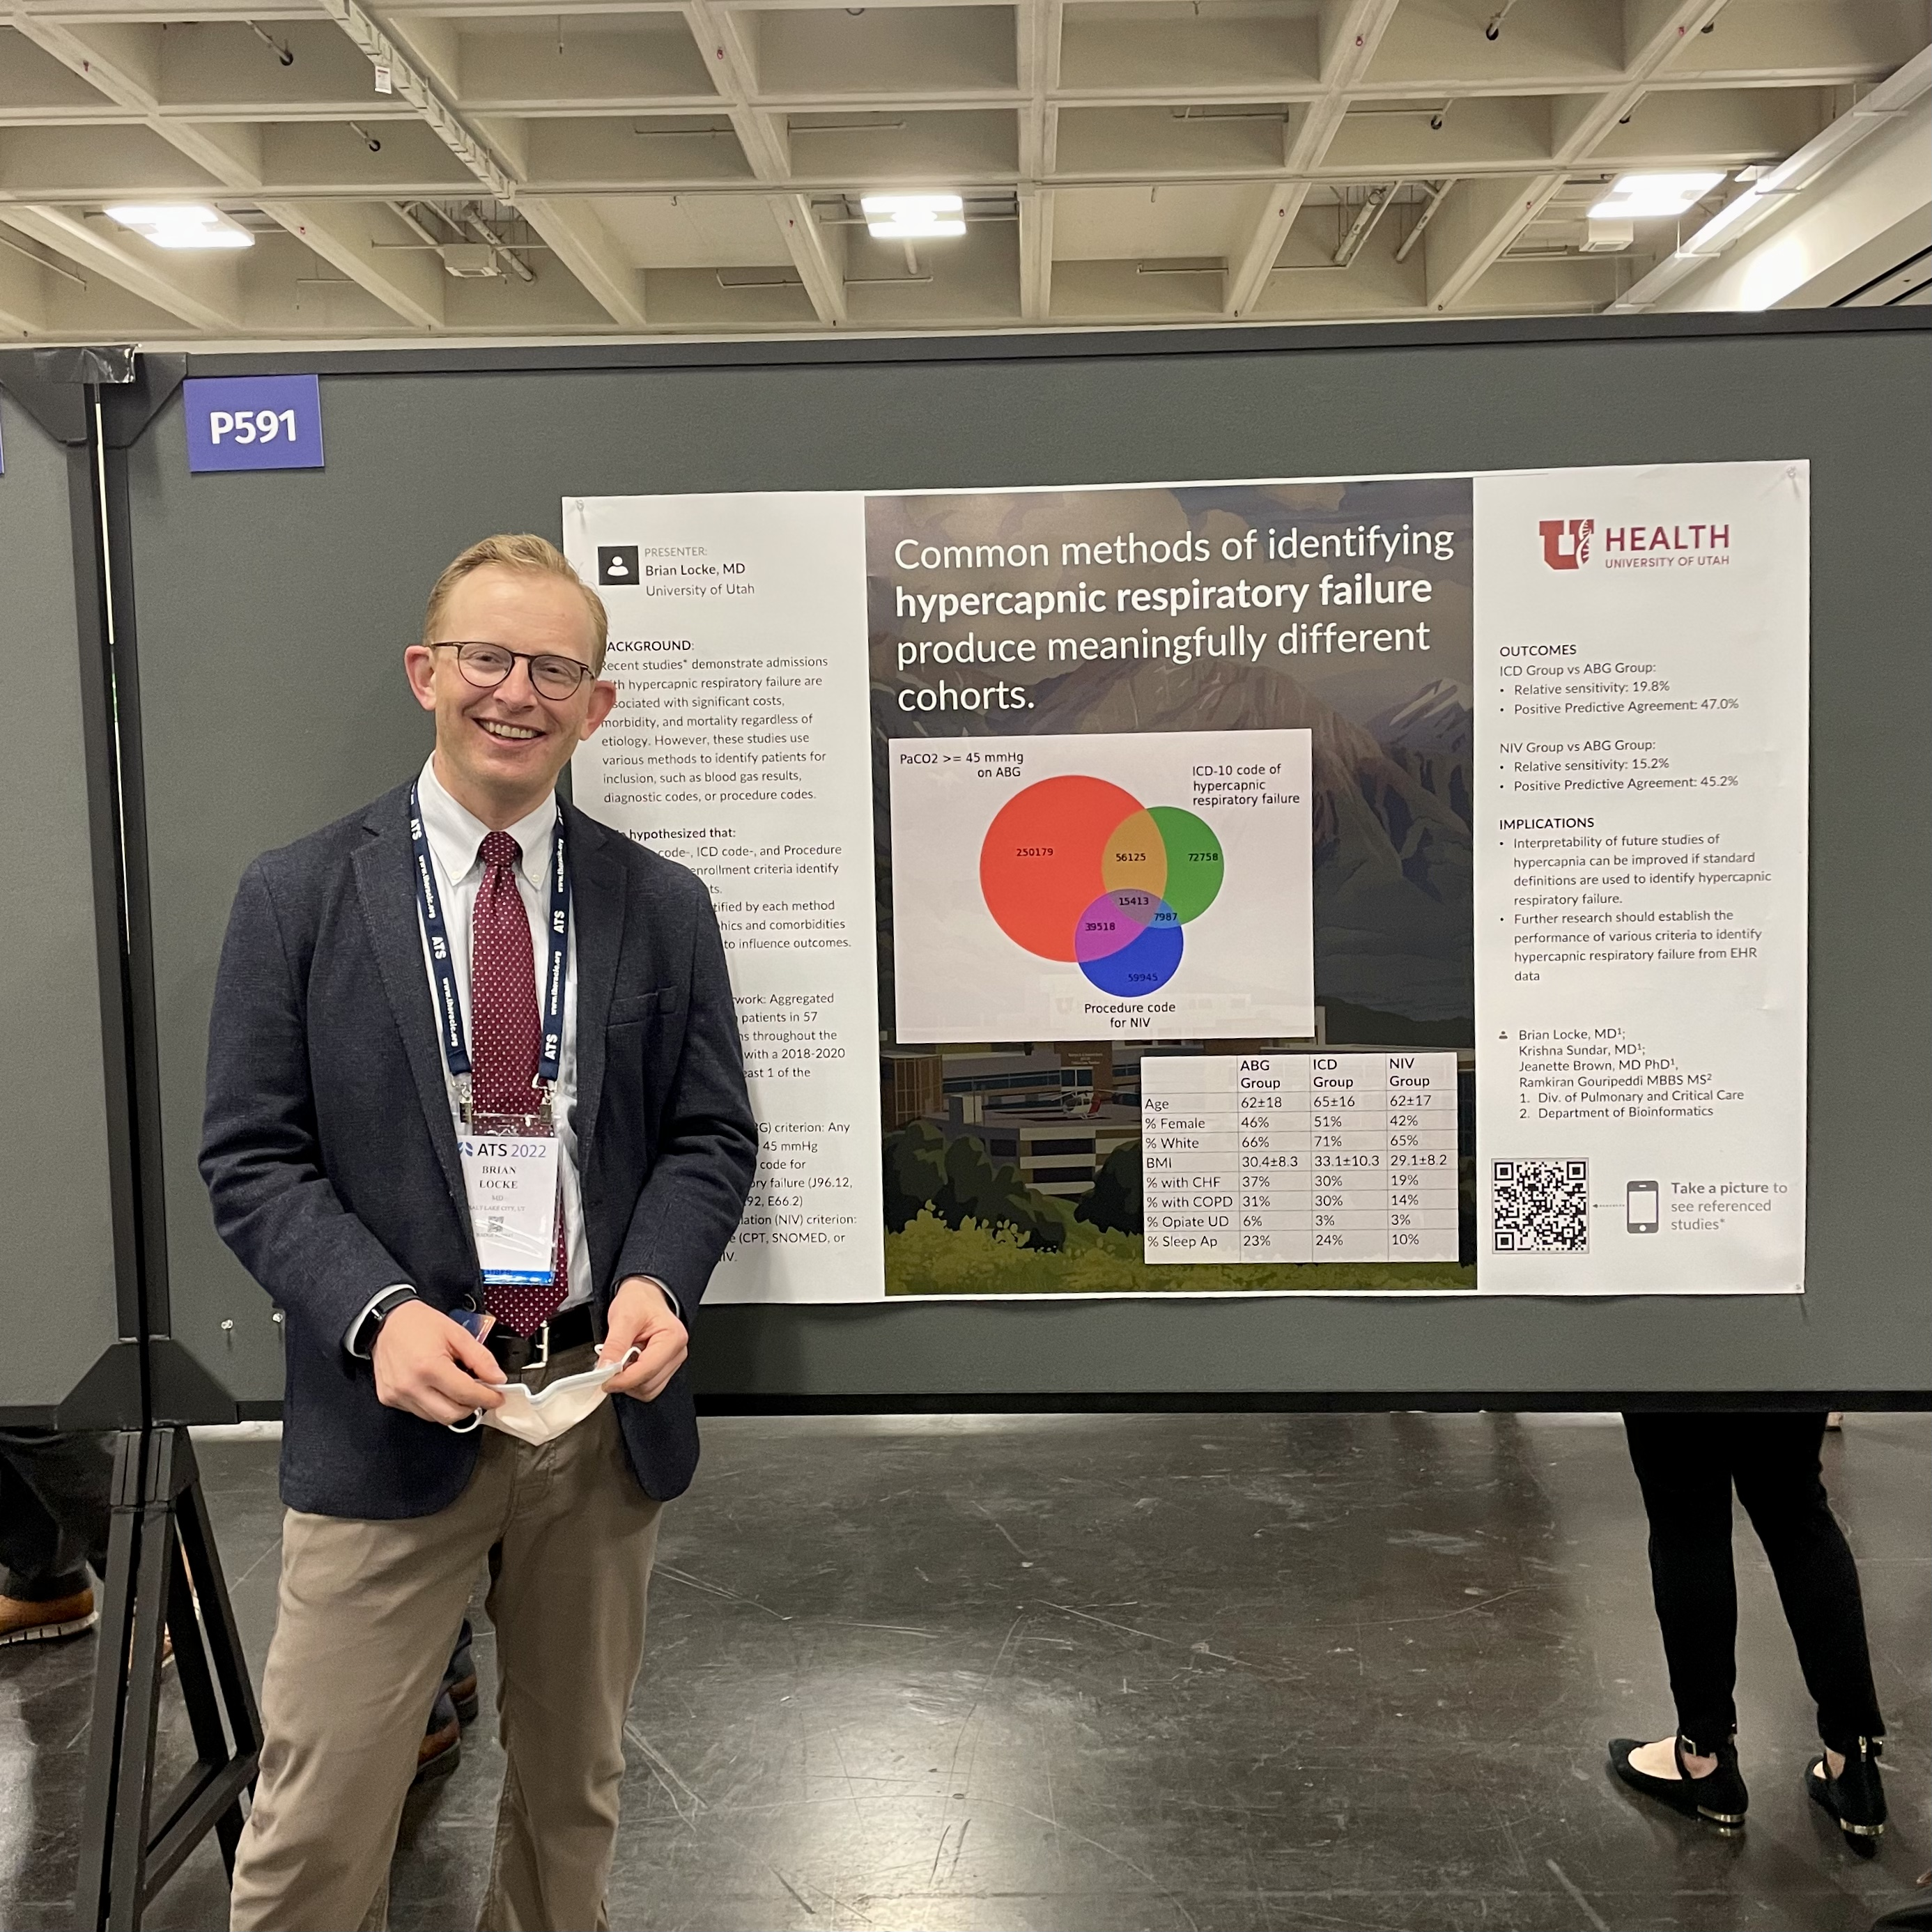
Common Methods of Identifying Hypercapnic Respiratory Failure Produce Meaningfully Different Cohorts Brian Locke
Krishna Sundar
Jeanette Brown
Ramikiran Gouripeddi

Slide 8
Common Methods of Identifying Hypercapnic Respiratory Failure Produce Meaningfully Different Cohorts Brian Locke, Krishna Sundar, Jeanette Brown, Ramikiran Gouripeddi
69 Million MRNs aggregated from 50 academic medical centers
Deidentified patient level data, including admissions, diagnoses, medications, procedures, and lab values.
Missing data?
Hypothesis 1: The methods used in prior studies of hypercapnic respiratory failure (billing code-, procedural code-, and blood-gas-based criteria) identify different patients.
Outcome: Relative Sensitivity; Positive Predictive Agreement
Hypothesis 2: The cohorts created by these differ methods differ in risk for outcomes of interest, which hampers interpretation of these studies.
Outcome: distribution of age, ethnicity, BMI, and frequency of coexisting diagnoses (OSA, opiate use disorder, COPD, CHF, and neuromuscular disease)
Notes:
Exclusion of other causes of hypoventilation
Obesity -> increased CO2 production and vent limitation from mass of chest wall and disadvantaged respiratory mechanics
“Other Causes”: Obstructive lung disease, neuromuscular / chest wall disease, things that suppress ventilatory drive (opiates), or causes of metabolic alkalosis (loop diuretics)
Likely routine to you all, but this is often botched in pulmonary and inpatient medicine.
Exclusion parameter
In research studies: A patient with mild COPD cannot have OHS. In reality – what do you do with a patient who has COPD so mild that it doesn’t cause OHS? Or, if it’s mild enough that it wouldn’t cause hypercapnia on it’s own? Open questions, problem with the paradigm.
“Exclusion of other causes of hypoventilation
Severe obstructive respiratory disease
Severe interstitial lung disease
Severe chest-wall disorders (eg, kyphoscoliosis)
Severe hypothyroidism
Neuromuscular disease
Congenital hypoventilation syndromes”

Slide 9
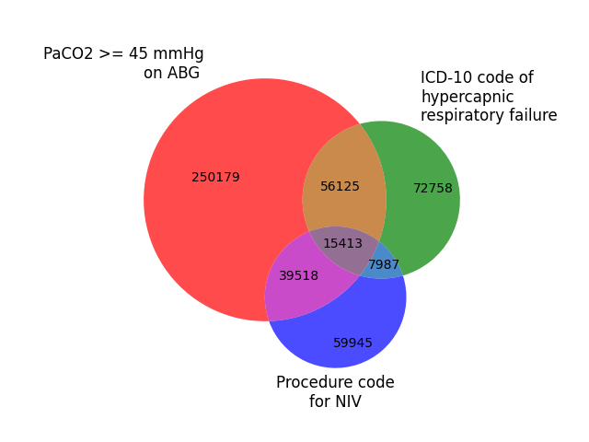
Common Methods of Identifying Hypercapnic Respiratory Failure Produce Meaningfully Different Cohorts Brian Locke, Krishna Sundar, Jeanette Brown, Ramikiran Gouripeddi
Preliminary Results
ICD Group:
Relative sensitivity (vs ABG): 19.8%
Positive Predictive Agreement (vs ABG): 47.0%
NIV Group:
Relative sensitivity (vs ABG): 15.2%
Positive Predictive Agreement (vs ABG): 45.2%
Notes:
Why start with inpatients with Hypercapnia?
Easier ascertainment
Informed presence bias
Labs
Data sources
Higher morbidity

Slide 10
Common Methods of Identifying Hypercapnic Respiratory Failure Produce Meaningfully Different Cohorts Brian Locke, Krishna Sundar, Jeanette Brown, Ramikiran Gouripeddi
 | ABG Group | ICD Group | NIV Group
Age | 62±18 | 65±16 | 62±17
% Female | 46% | 51% | 42%
% white | 66% | 71% | 65%
% Black | 18% | 19% | 17%
BMI | 30.4±8.3 | 33.1±10.3 | 29.1±8.2
% with CHF | 37% | 30% | 19%
% with COPD | 31% | 30% | 14%
% Opiate UD | 6% | 3% | 3%
% Sleep Apnea | 23% | 24% | 10%
Remaining Analyses:
Stratification by time of ABG
Data integrity checks:
Require each type of info from source during admission
Sensitivity analysis among patients with all 3 data-types

Slide 11
Common Methods of Identifying Hypercapnic Respiratory Failure Produce Meaningfully Different Cohorts Brian Locke, Krishna Sundar, Jeanette Brown, Ramikiran Gouripeddi
For accurate determination of
Trends in hypercapnic respiratory failure incidence
Frequency of different comorbidities or component causes
Morbidity and mortality associated with hypercapnia
Who should be included in future studies to determine frequency benefit from treatment
... method of patient identification likely matters
Questions?
…next steps

Slide 12

Computable Phenotype
How should we identify patients for these studies?
Pretest * Information = Post-test confidence
Definition: electronic cohort definition for enrolling patients
Can use machine learning or other complex algorithms
Or, can be human understandable (understandable, trustable, generalizable)
Hypothetical example
Include if any of the following | Exclude if any of the following
First ABG PaCO2 > 45 mmHg | Receiving IMV prior to blood gas
Serum HCO3 over 27 and BMI over 35 | Within 3 hours of anesthesia
ICD code for hypercapnic RF
ICD code for any resp failure, VBG with PaCO2 > 50 and SO2 over 50%*
Etc..
Notes:
Pretest probability and bayes rule:
If you enrich the population by other features, you need a less powerful to test to reach a given level of certainty. So while an ABG of 45 confirms hypercapnia regardless of the clinical situation, someone who **ALMOST certainly has hypercapnia**, even just an elevated bicarbonate may be enough
This is the idea behind the age adjusted D-dimer

Slide 13
Study design:
IRB approved
Request EDW data on all patients admitted (2015- ) meeting any of the following enrichment criteria:
Diagnostic code for respiratory failure
Blood gas obtained during admission
Procedure code for starting non-invasive or invasive mechanical ventilation or CPAP
BMI over 30 & HCO3 over 25?

Slide 14
Study design:
Random sample of charts: in each category*
Review by 2 raters (inter-rater agreement)
Reference “Silver Standard”
Classification:
Definite non-iatrogenic hypercapnic respiratory failure
Probable iatrogenic hypercapnic respiratory failure
Probable non-iatrogenic hypercapnic respiratory failure
Uncertain hypercapnic respiratory failure
Hypercapnic respiratory failure excluded

Slide 15
Study design:
Calculate Se and Sp for Definite and Probable non-iatrogenic hypercapnic respiratory failure with various definitions
# of charts? Est 300 UU patients/month in Venn
-- 15,000 population, 95% CI, 5% margin and 10% expected proportion with ‘true’ hypercapnia
120 charts to review.
Generalizability: Regenerate venn-diagram on TriNetX data (nationally representative data)
Implication: if patterns of overlap similar, accuracy may be too

Slide 16
Caveats:
Will inter-rater agreement be sufficient?
Do we know what the concept should mean?
Is “Hypercapnic Respiratory Failure” too heterogenous to study?
Studying ’syndromes’ haven’t been particularly fruitful
Intended use: enroll in studies
Not: Best-practice alert to consider hypercapnia in an individual patient
Is UT generalizable to everywhere else?
What ‘features’ should we use to generate the rules?
Age? (analogy: Age-adjusted D-dimer, similar epidemiology)
[HCO3-]? …

Slide 17
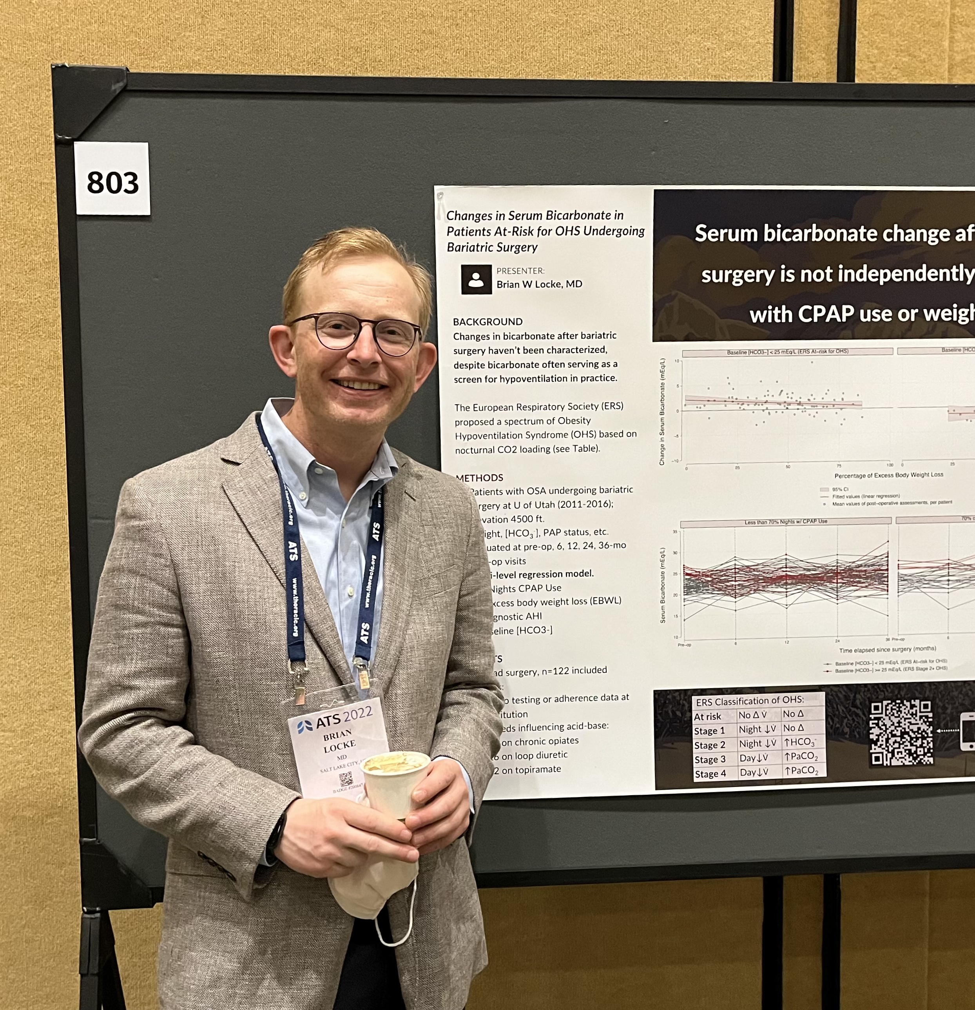

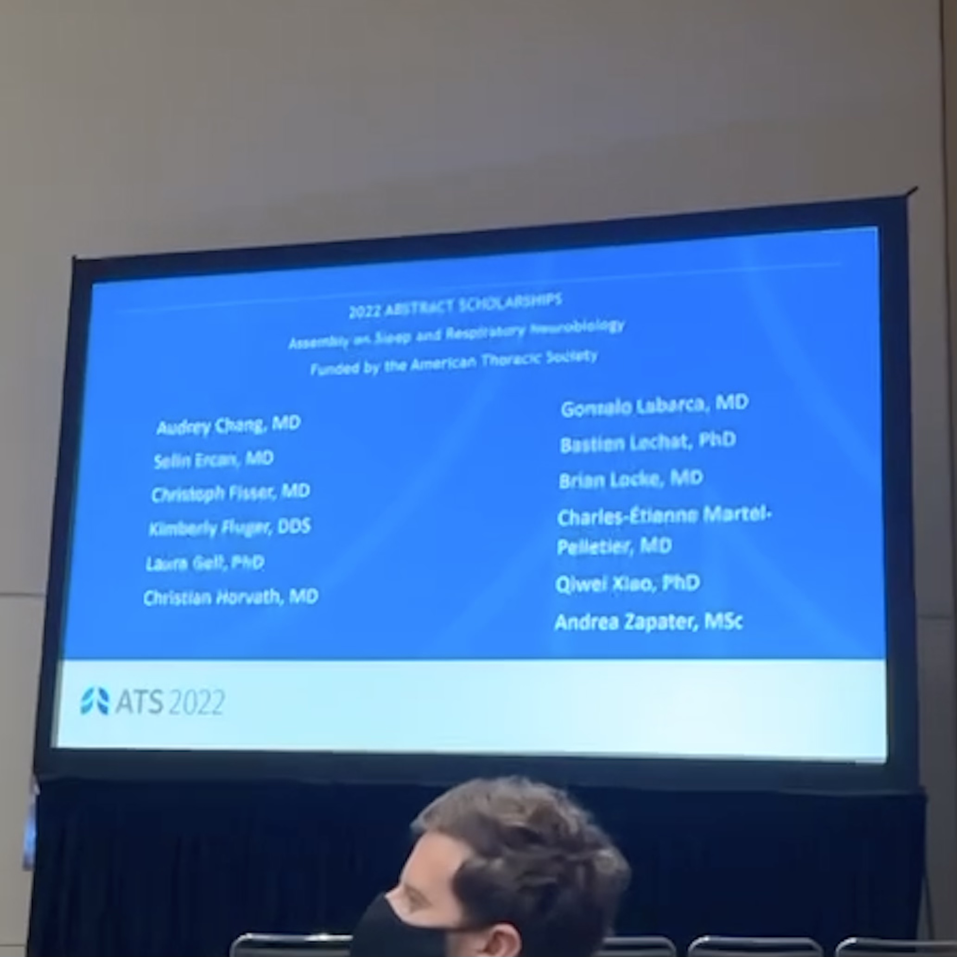
Changes in Bicarbonate in Patients at Risk for Obesity Hypoventilation Undergoing Bariatric Surgery Brian Locke, Conrad Addison, Somya Mishra, Krishna Sundar

Slide 18
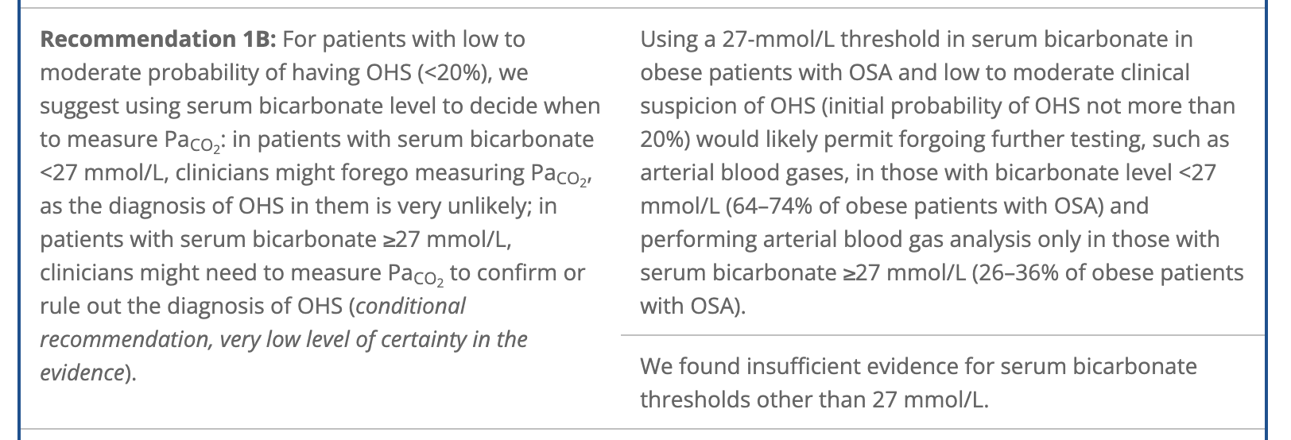
Pooled-analysis of 5 studies (n=335 w/ OHS, n=1037 eucapnic obese)
Serum HCO3 >= 27 mEq/L: +LR 3.74; -LR 0.18

Slide 19

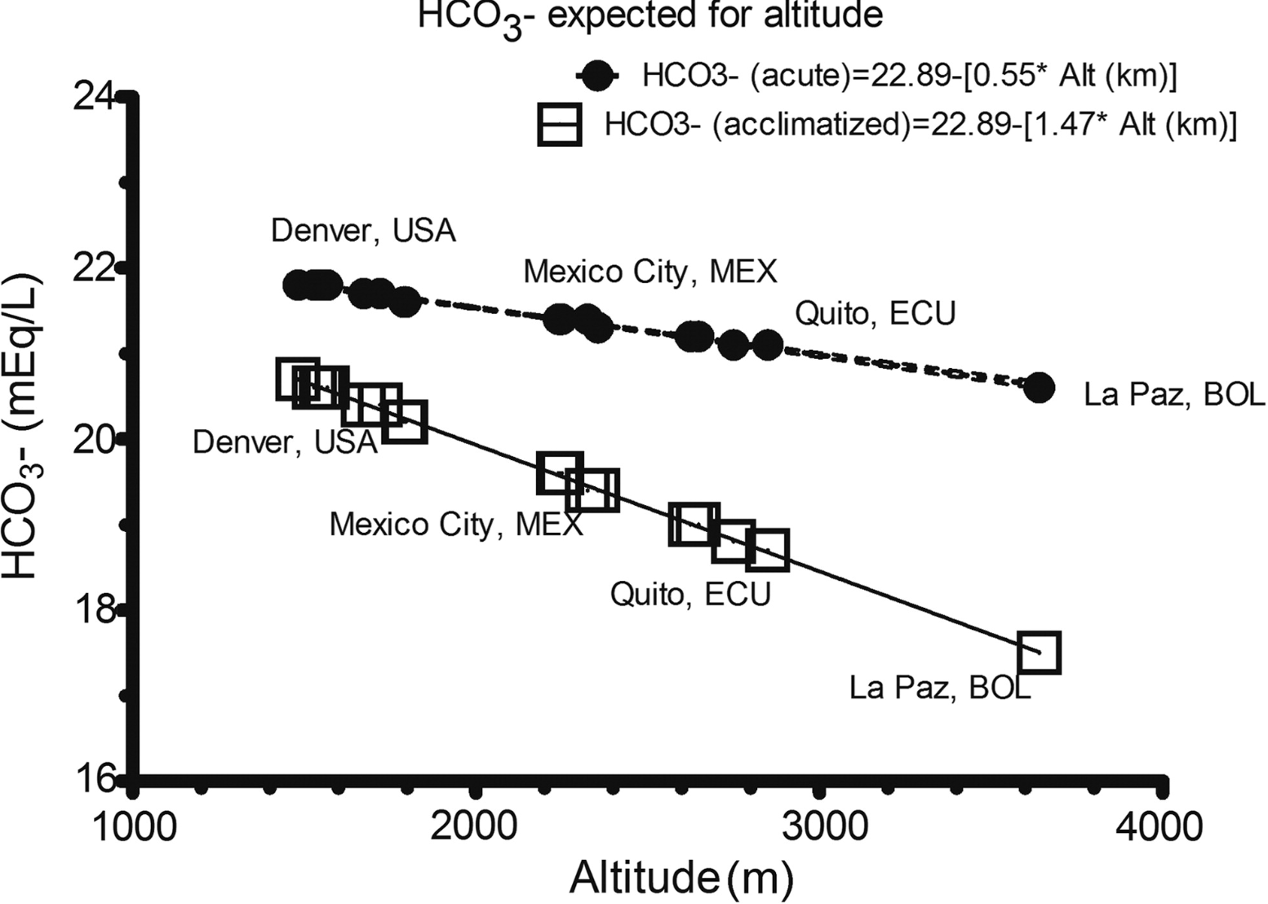
“In acclimatized people, the decrease in [HCO3-] is 1.5 mEq/L per each 1000 m”
Change in variance?
Notes:
Remember, 3.5 mEq/L for each 10 mmHg co2 is expected.
More recent evidence suggests that it is close to 4.5 mEq/L per 10, but depends on renal function.

Slide 20
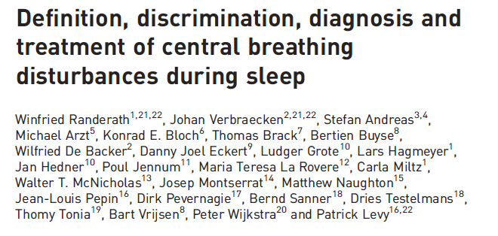
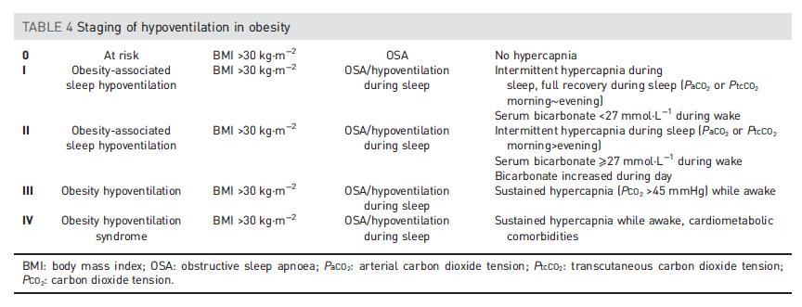
Changes in Bicarbonate in Patients at Risk for Obesity Hypoventilation Undergoing Bariatric Surgery Brian Locke, Conrad Addison, Somya Mishra, Krishna Sundar
ERS 2018: Obesity-related hypoventilation paradigm
Notes:
Exclusion of other causes of hypoventilation
Obesity -> increased CO2 production and vent limitation from mass of chest wall and disadvantaged respiratory mechanics
“Other Causes”: Obstructive lung disease, neuromuscular / chest wall disease, things that suppress ventilatory drive (opiates), or causes of metabolic alkalosis (loop diuretics)
There is a need for parameters to identify and monitor patients with hypoventilation, both in clinic and epidemiologically.
In addition to screening (as recommended in ATS guideline), ERS incorporates that understanding into their disease conception
Likely routine to you all, but this is often botched in pulmonary and inpatient medicine.
Exclusion parameter
In research studies: A patient with mild COPD cannot have OHS. In reality – what do you do with a patient who has COPD so mild that it doesn’t cause OHS? Or, if it’s mild enough that it wouldn’t cause hypercapnia on it’s own? Open questions, problem with the paradigm.
“Exclusion of other causes of hypoventilation
Severe obstructive respiratory disease
Severe interstitial lung disease
Severe chest-wall disorders (eg, kyphoscoliosis)
Severe hypothyroidism
Neuromuscular disease
Congenital hypoventilation syndromes”

Slide 21
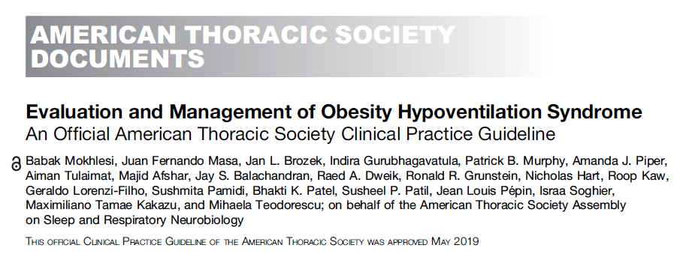
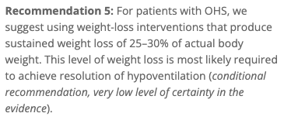
Changes in Bicarbonate in Patients at Risk for Obesity Hypoventilation Undergoing Bariatric Surgery Brian Locke, Conrad Addison, Somya Mishra, Krishna Sundar
Hypothesis 1: [HCO3-] has low enough biologic variation to functional usable surrogate for nocturnal CO2 retention peri-bariatric surgery
Outcome: intra-patient variability in measurement, frequency of metabolic disturbances
Hypothesis 2: Δ[HCO3-] has construct validity as an index of response to interventions that decrease nocturnal CO2 loading
Δ[HCO3-] will be higher in patients who lose more weight, or who adhere to CPAP.

Slide 22
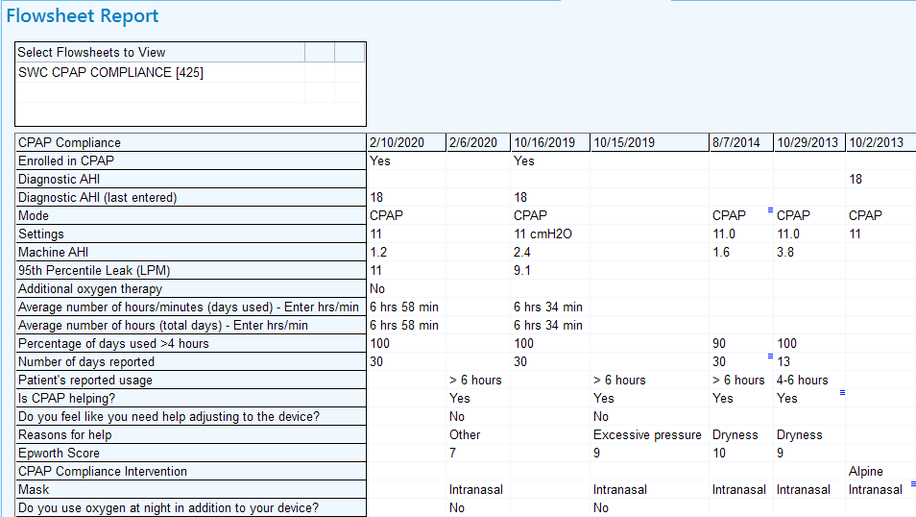
Methods
Retrospective Cohort
Patients: Adult patients undergoing bariatric surgery at U of Utah (2011-2016): n=358 had surgery, n=122 included Exclusions:
n=167 no testing or adherence data at our institution; 1 w/ AHI < 5
n=68 (36%) meds influencing acid-base; 6 on multiple:
n=15 on chronic opiates
n=26 on loop diuretic
n=22 on topiramate
Data: extracted from EHR. Evaluated at pre-op, 6, 12, 24, 36, 48, 60-mo post-op
Key exposure (time-varying): Weight (Excess Body Weight Lost; IBW = BMI 22)
Key exposure (time-invariant): average PAP adherence taken from available remote-tracking flowsheets.
Outcome: Serum [HCO₃⁻]

Slide 23
 | Total | Male | Female | p-value
 | N=122 | N=30 | N=92
Age at surgery | 44.0 (37.0-55.0) | 42.5 (38.0-54.0) | 44.5 (36.0-56.0) | 0.80
BMI (kg/m^2) at surgery | 43.0 (39.8-47.8) | 41.9 (39.9-45.9) | 43.3 (39.8-48.6) | 0.21
Weight category |  |  |  | 0.91
Obesity (30-35) | 2% (3) | 3% (1) | 2% (2)
Severe Obesity (35-40) | 26% (32) | 27% (8) | 26% (24)
Severe Obesity (40+) | 70% (86) | 67% (20) | 72% (66)
Missing | 1% (1) | 3% (1) | 0% (0)
Charlson Comorbidity Index at baseline | 2.0 (1.0-4.0) | 2.5 (1.0-3.0) | 2.0 (1.0-4.0) | 0.38
Ever prescribed oxygen? | 33% (40) | 23% (7) | 36% (33) | 0.20
Sleep study available? | 81% (99) | 70% (21) | 85% (78) | 0.072
Diagnostic AHI (events/hr) | 23.1 (13.5-47.4) | 33.1 (18.5-59.5) | 20.4 (12.0-39.5) | 0.050
OSA Severity |  |  |  | 0.30
Mild | 23% (28) | 20% (6) | 24% (22)
Moderate | 20% (24) | 17% (5) | 21% (19)
Severe | 30% (36) | 43% (13) | 25% (23)
Missing | 28% (34) | 20% (6) | 30% (28)
Any CPAP use in followup? | 72% (88) | 80% (24) | 70% (64) | 0.27
CPAP use 70%+ nights? | 25% (31) | 43% (13) | 20% (18) | 0.009
Percentage of excess body weight lost at lowest weight during follow-up | 0.51 (0.40-0.69) | 0.56 (0.42-0.70) | 0.51 (0.38-0.67) | 0.28
HCO3 prior to surgery | 22.0 (21.0-24.0) | 22.5 (21.0-24.5) | 22.0 (21.0-23.5) | 0.17
sCr before surgery | 0.8 (0.8-0.9) | 0.9 (0.8-1.0) | 0.8 (0.8-0.9) | 0.043
Presence of ERS stage 2 or higher OHS | 17% (21) | 23% (7) | 15% (14) | 0.31
Notes:
IQR

Slide 24
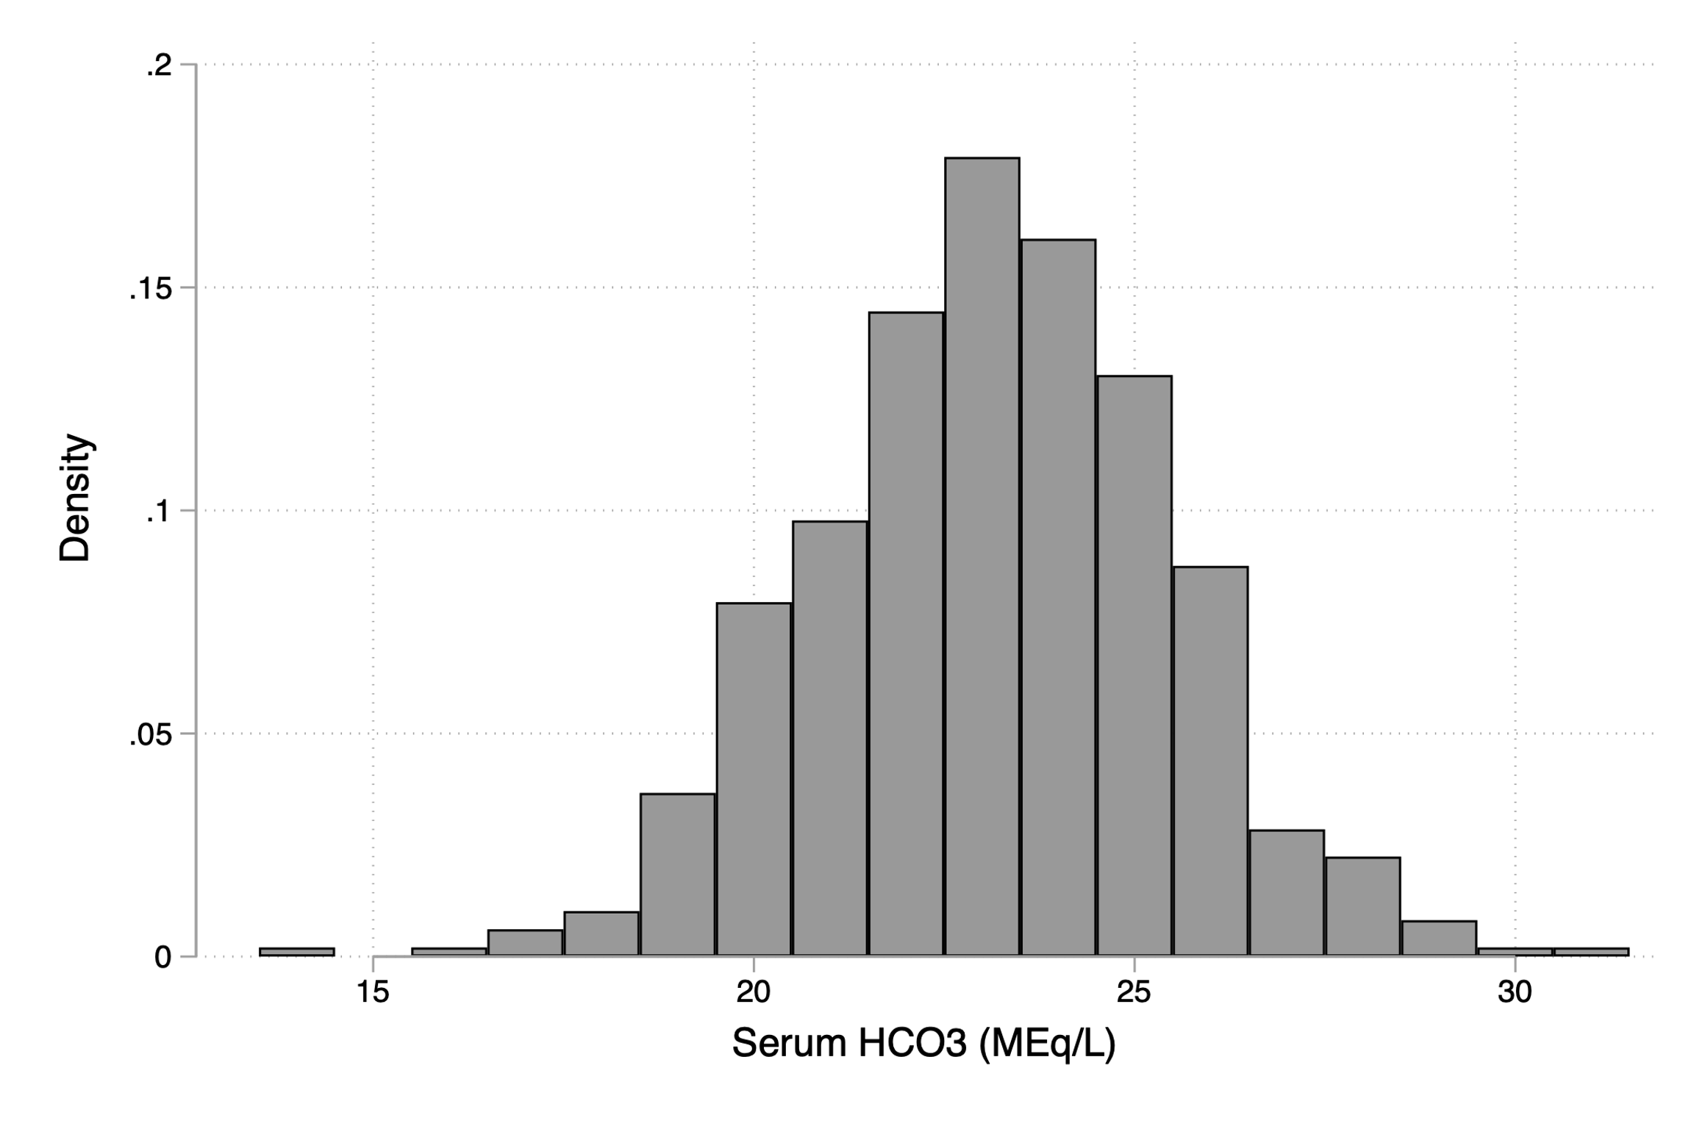
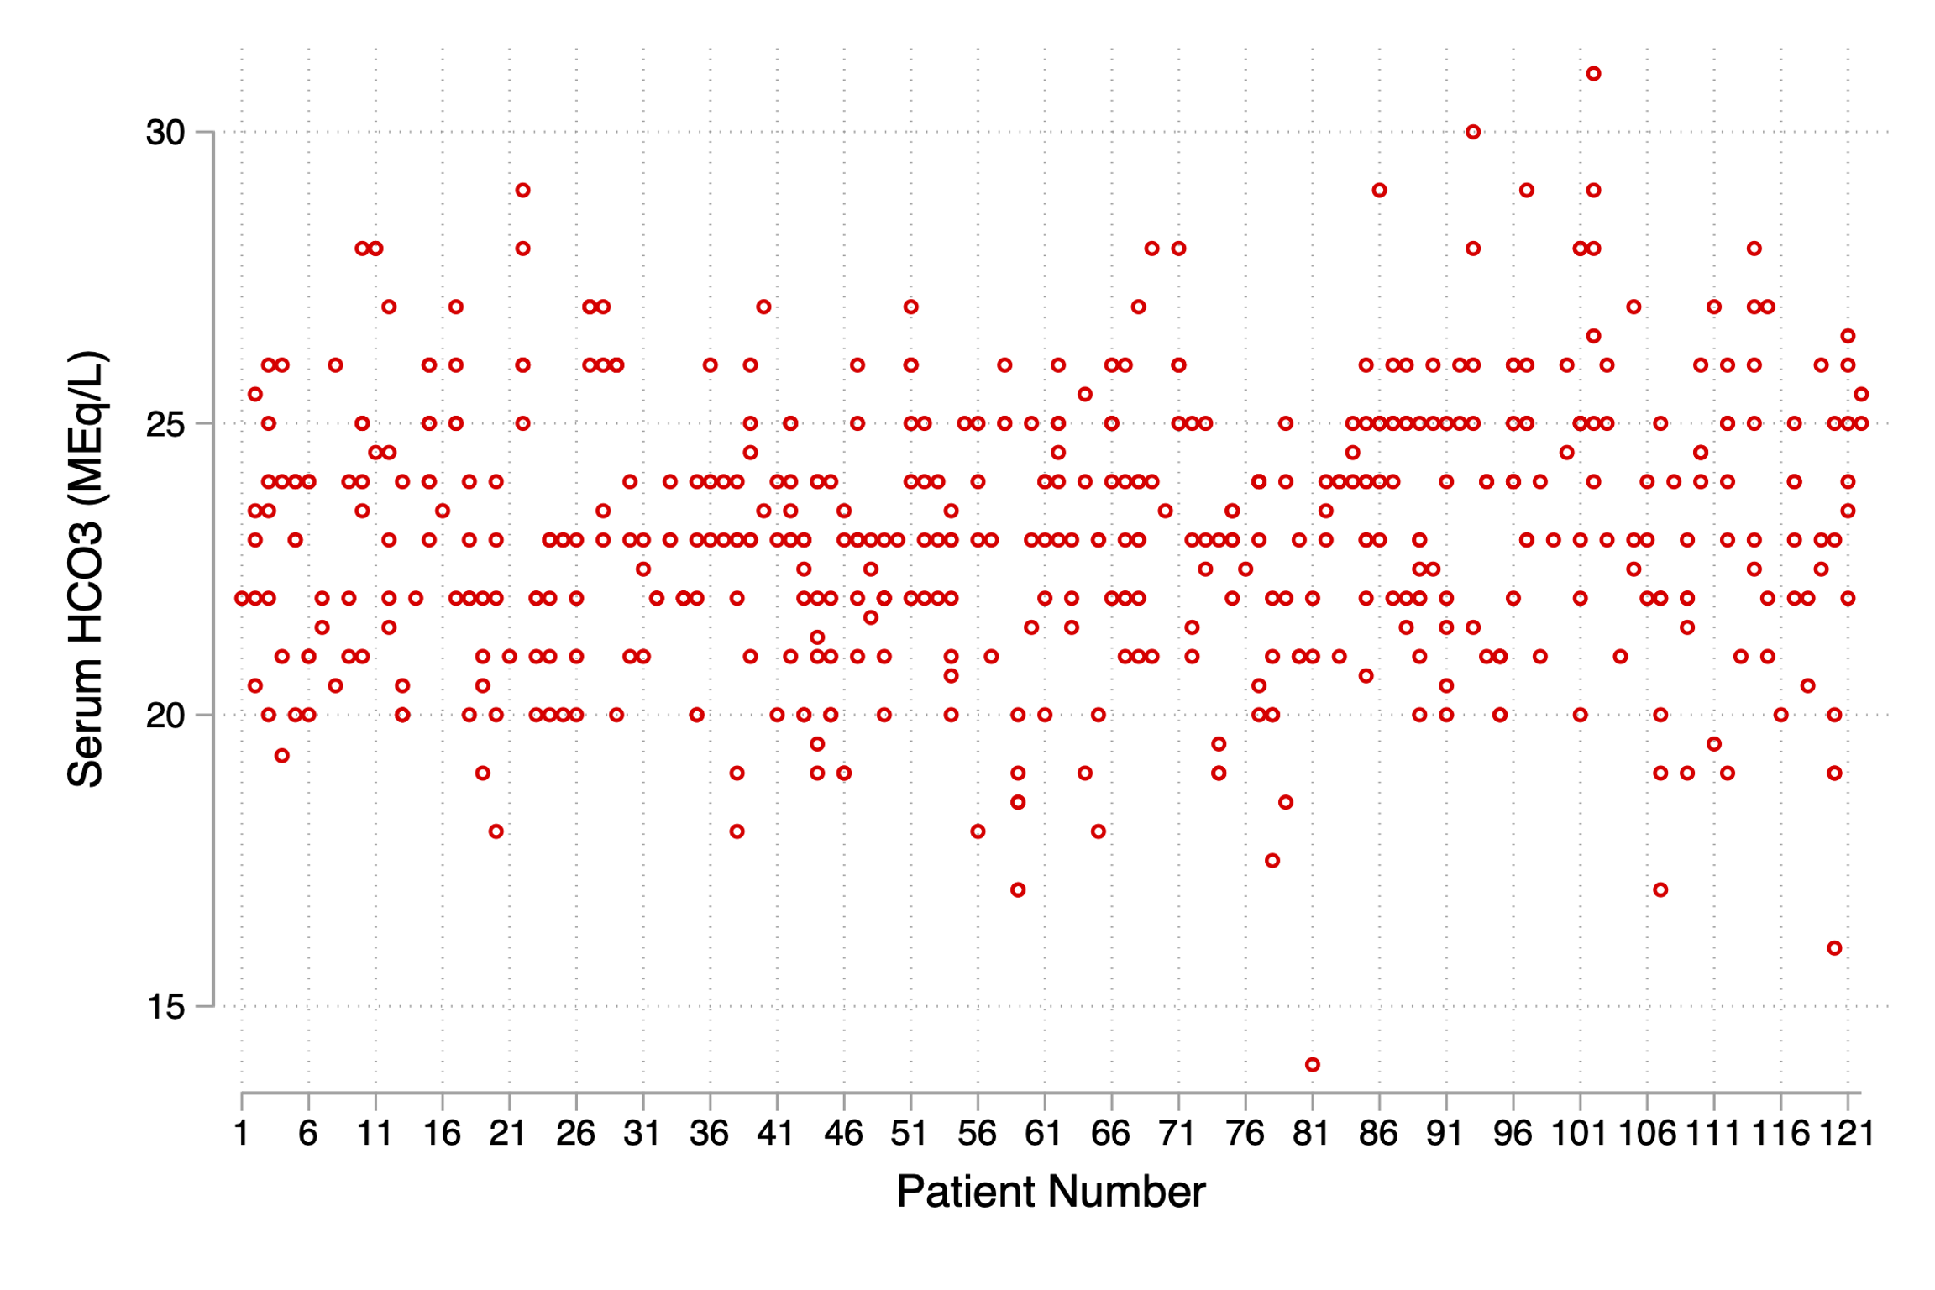
Hypothesis 1: [HCO3-] is a usable surrogate for nocturnal CO2 retention peri-bariatric surgery
36% excluded for competing metabolic disturbances
Intraclass Correlation Coefficient = % of variability explained by who is getting the blood draw (allowing for linear trend): 0.37 (95% CI 0.28-0.47)
Notes:
Remember – for our purposes, everything that is not the compensation for a respiratory acidosis is noise

Slide 25
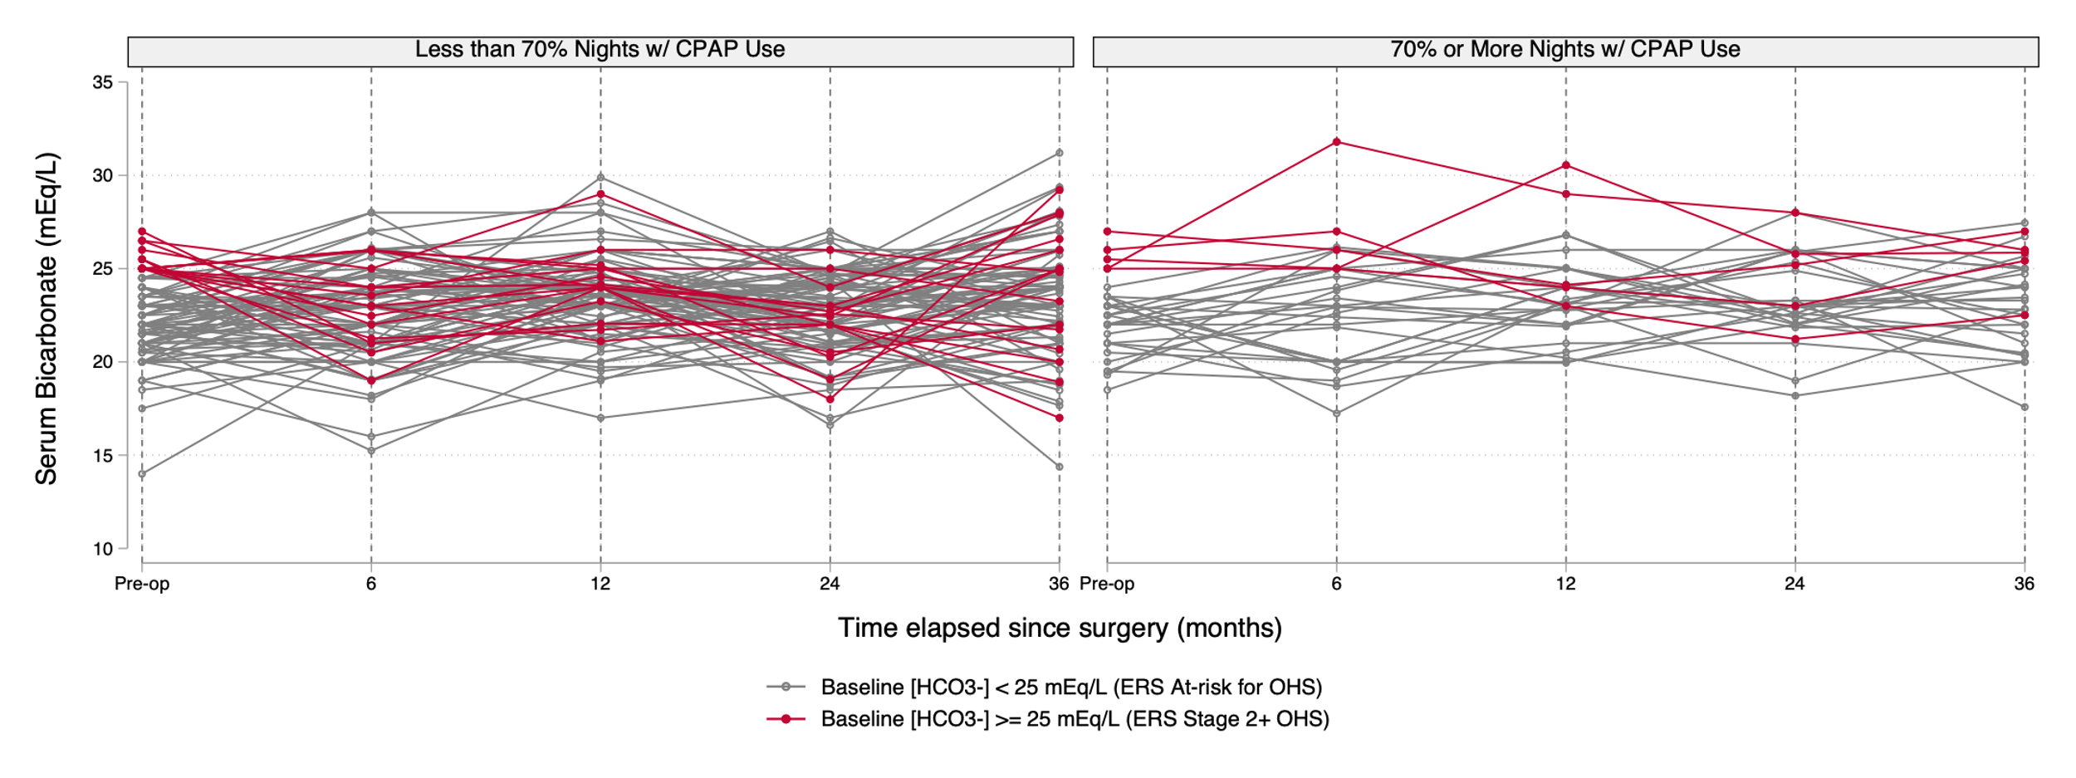
Hypothesis 2: Δ[HCO3-] will be higher in patients who lose more weight or who adhere to CPAP.

Slide 26
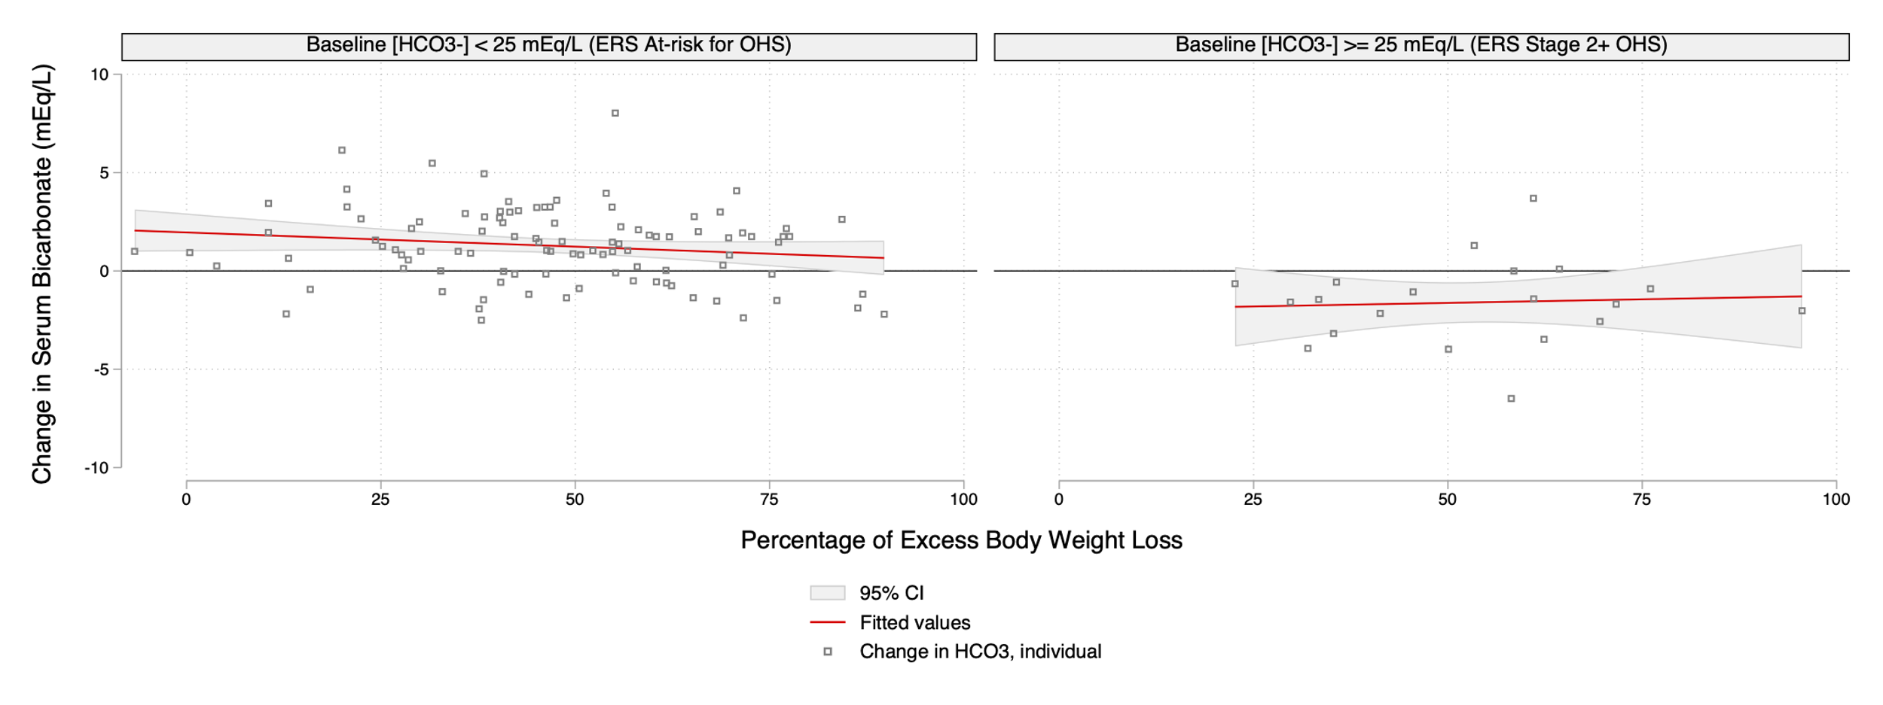
Hypothesis 2: Δ[HCO3-] will be higher in patients who lose more weight or who adhere to CPAP.

Slide 27
Hypothesis 2: Δ[HCO3-] will be higher in patients who lose more weight or who adhere to CPAP.

Slide 28
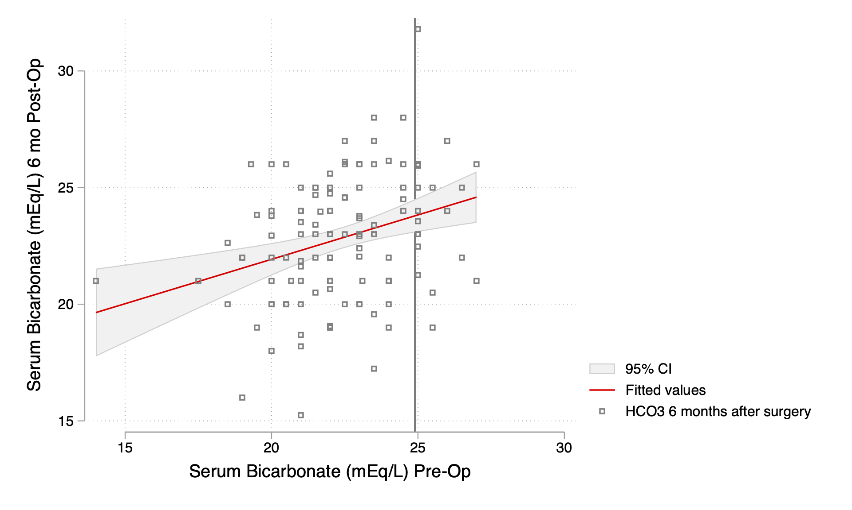
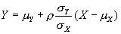
Problem: Regression to the mean
3 Ways to address:
Control group
Multiple baseline measurements
Use ANCOVA (aka linear regression) with baseline [HCO3-] as a predictor
where is the correlation between X and Y (0.31). How we use this depends on what data we have and how reliably we can estimate the elements of the equation.
Notes:
(https://www.bmj.com/content/323/7321/1123.full)

Slide 29
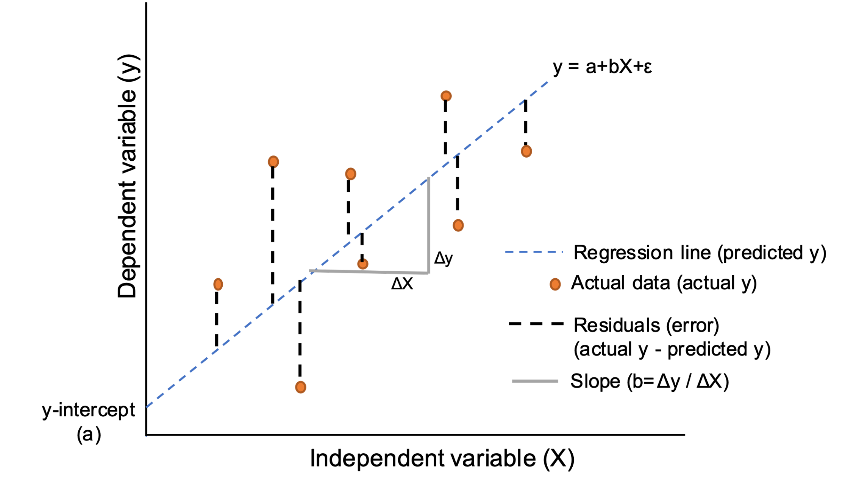
Linear mixed(—effect) modeling
Regression: take some input variables→ predict an outcome ([HCO3-])
Idea: Use if data is clustered (repeat measures on the same person, each person belongs to a group, etc.)
Regression prediction has an error compared to observed (‘residual’) – break that down into: how far the person is (on avg) away from the sample mean, and how abnormal the individual measurement is from the persons average. What you get:
The influence of each of the predictors, accounting for the grouping.
Repeated measures of same person are not independent (ICC: 0.37)
Inter-
Intra-
Notes:
Mixed model; multilevel model; mixed effects regression model; hierarchical linear model
When data is the same at each time point in follow-up = time-invariant
Time-variant = if has a different value at each follow-up point
Add error term (ie. intercept) per patient to each – these aren’t measured but assumed on aggregate to not contribute. (mean 0). We do estimate the variance.
The beta terms = fixed terms
The k error terms = random terms (representing the common error from all the individuals the ’group’/2nd level)
bicarb months bicarb0 age_n Female AvgCompliance ebwl DiagAHI

Slide 30
Linear mixed model Inputs: Baseline [HCO3-], Age, Gender, %Nights w/ PAP use, Diagnostic AHI, Excess Body Weight Loss Missing data: multiple Imputation with chained equations Interactions between Age*Gender (menopause), Diag AHI*CPAP Use, HCO3- dichotomized: no effect.
Predictor | Marginal Effect (mEq/L of [HCO3]) | 95% CI (mEq/L of [HCO3]) | P-value
Starting [HCO3-] per mEq/L | 0.22 | 0.081 to 0.35 | P = 0.002
Months post-op (per 6 mo) | 0.11 | -0.017 to 2.30 | P = 0.09
Age (per decade) | 0.35 | -0.003 to 0.076 | P = 0.07
Female gender | -0.39 | -1.49 to 0.71 | P = 0.48
Compliance (per 10% nights used) | -0.0050 | -0.13 to 0.11 | P = 0.94
Excess body weight lost (per 10%) | 0.071 | -0.13 to 0.27 | P = 0.47
Diagnostic AHI (per 10 events/hr) | -0.032 | -0.18 to 0.12 | P = 0.68
Marginal Effect: how much does [HCO3-] change during follow-up if you change the predictor variable, holding everything else constant?

Slide 31
Hypothesis 2: Δ[HCO3-] will be higher in patients who lose more weight or who adhere to CPAP.
No. Why not?
Not very much OHS in our group
Elevation? Even with generous correction of 27 → 25 mEq/L (0.55-1.5 mEq/L per 3281 ft above sea level)
Mostly pre-menopausal females; Progesterone protective?
Some already optimized on PAP prior to enrollment? (wouldn’t influence non-adherers)
Competing metabolic acid-base disturbances?
Need stratification by type of weight loss surgery (some chart review)
Maybe the ERS framework is not accurate?
ERS Classification of OHS:
At risk | No Δ V̇ | No Δ
Stage 1 | Night ↓V̇ | No Δ
Stage 2 | Night ↓V̇ | ↑HCO₃⁻
Stage 3 | Day↓V̇ | ↑PaCO₂
Stage 4 | Day↓V̇ | ↑PaCO₂

Slide 32
Summary and Next Steps
Barriers to HCO3- usability to track hypoventilation peri-bariatric surgery:
~1/4 to 1/3 on meds expected to interfere with relationship.
Significant variability between measurement of same person.
Did not follow expected trends in improvement among a young, mostly female cohort at altitude with minimal compensatory alkalosis.
Stratify by surgery
Venue? Letter to editor?

Slide 33
Implications for broader research aims?
HCO3- by type of hypercapnic respiratory failure?
Pattern of CO2 loading may differ.
HCO3- may not be as good in acutely decompensated respiratory failure (compared to stably diagnosed OHS)

Slide 34



Useful References
TriNetX / EMR Phenotype | Bicarbonate in Bariatric Surgery

Slide 35
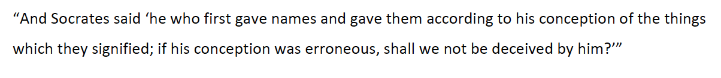
Challenges to this work:
Is hypercapnic respiratory failure a useful ‘syndrome’ epidemiologically?
It clearly is important diagnostically
Are different causes of hypercapnic respiratory failure more similar, or less?
Notes:
Any biological tube reacts with a very limited and stereotypic set of responses, irrespective of the
underlying cause. This is hardly a revolutionary concept: irrespective of how it is damaged, the failing
kidney cannot excrete creatinine, and blood levels rise.
Treatable traits… for hypercapnic respiratory failure?
-- component of ventilatory drive at baseline, and how robust those ventilation changes are to changes?
-- component of ventilatory ability
-- component of VCO2 production
Coming from small physiologic studies vs coming from Epidemiologic lens
Quote from Twitter/Epidemiology about the ‘purpose’ of naming

Slide 36
Possible next steps:
Is hypercapnic respiratory failure becoming more common?
What are the most common causes of hypercapnic respiratory failure?
Possible study design:
What proportion of hypercapnia include OSA as a contributing cause?
Does ambient air pollution increase the risk of hypercapnic respiratory failure
Can you extract clinically salient aspects of hypercapnic respiratory failure – can’t breathe won’t breathe – from the chart.
Subphenotyping: best when supported by plausible mechanisms.

